Slide 1
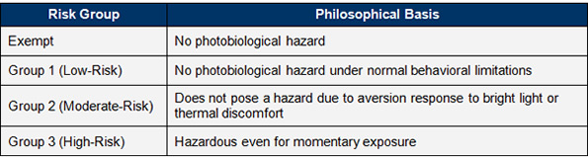
Microscope Systems with LEDs
LED Illumination
Many microscope systems now use high powered LEDs for widefield fluorescence illumination.
LEDs were taken out of the laser classification system about ten years ago and are now classified in a similar way to bright lamps.
Unlike with lasers there is no legal requirement for companies to label LED products with a safety classification.
- It is therefore best to measure the accessible power output of LED based systems to make sure that the
levels are safe.
Most LED systems attached to microscopes (e.g. CoolLED / Lumencore) are RG2 but some of the more powerful UV and IR lamps might be considered RG3.

Slide 2
Microscope Systems with LEDs
LED Illumination
Reflections of the LED light at the sample stage are unlikely to be dangerous but it is best to avoid staring at the scattered LED light at the stage as a precaution.
LED power should be set as low as practicable for the experiment.
Direct viewing of the LED excitation light should be avoided and fibre optics and enclosure panels should not be removed while the LEDs are switched on.

